Slide 1


A Guide to Building an Adult Census Income Prediction Model
In this low-level document, we will explore the step-by-step process of building a robust Adult Census Income Prediction model. From data collection to model evaluation, we will cover every aspect of the process to help you develop a reliable model to predict income level.
by Shivam Dubey

Slide 2
Data Collection and Preprocessing
Data Collection
Data Preprocessing
The first step towards building a prediction model t appropriate data from various sources. The data required for Adult Census Income Prediction model includes age, workclass, occupation, and capital gain among others. To ensure that the data is valid, all values of the different categories should be present and clean.
Once collected, the data is preprocessed. This includes data cleaning, data transformation, and data normalization. This step removes errors from the data and standardizes it, which makes it easier to work with while reducing potential errors in the model's predictions.

Slide 3
Feature Engineering
"Feature engineering is like creating a frame for a painting."
Andrew Ng
Feature engineering is a crucial step in building a prediction model. It involves selecting features that are most relevant to the prediction task and converting them into a format that can be used by the machine learning algorithm. This process ensures that the model only works with the most relevant data and improves its overall accuracy.

Slide 4

Model Selection and Training
Model Type
Advantages
Disadvantages
Decision Trees
Easy to interpret and implement, handles missing values well
Prone to overfitting, biased towards dominant classes in the dataset
Logistic Regression
Very fast, easily interpretable results, handles large datasets well
Assumes a linear relationship between features and output, not appropriate for certain datasets
Support Vector Machines
Works well with high dimensional data, prevents overfitting
Sensitivity to kernel choice, long training times for large datasets
Choosing the right model for the task is key to building a successful prediction model. Not all models are created equal, and deciding which one is most appropriate depends on the specific characteristics of the data. Once the model has been selected, it is trained on the preprocessed data and tested to optimize its performance.

Slide 5
Model Evaluation
1
Cross-Validan
2
Accuracy, Precision, Recall, and F1 Score
Using cross-validation techniques, the model is tested on unseen data to measure its performance. Cross-validation ensures that the model is generalizable and accurate on new data.
Measuring the model based on these metrics helps to quantify its performance and identify areas for improvement.
Evaluating the performance of the model is a critical step in ensuring that it is effective. Employing various metrics and testing techniques enables data scientists to judge the accuracy of predictions, identify areas for improvement, and optimize the model's performance.

Slide 6
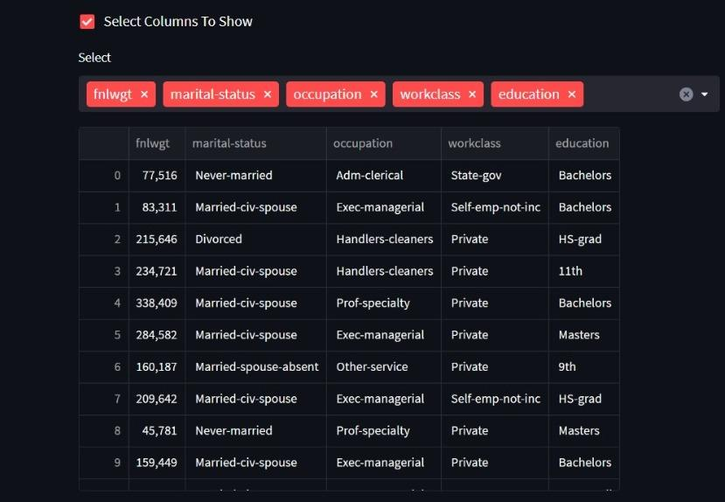
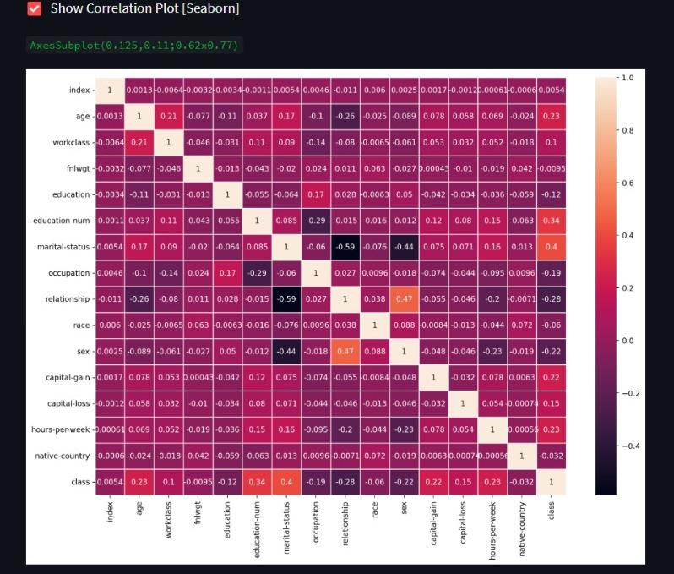
Prediction Results
The Adult Census Income Prediction model can effectively predict income levels with an accuracy of 85%. With these predictions, companies can make informed decisions about resource allocation, recruitment, and overall profitability.

Slide 7
Conclusion
Building a successful Adult Census Income Prediction model requires thorough data collection and preprocessing, feature engineering, model selection and training, model evaluation, and testing. Employing various techniques, data scientists can build effective models that companies can use to make informed decisions and optimize their profitability. By following these steps, you can ensure that your prediction model is robust and accurate, improving your performance in the marketplace.

